Slide 1

OSNF
LECTURE
Memory Management
Operating Systems &
Networking Fundamentals
Diploma in CSF/IT
Year 1 (2021/22), Semester 2
4
Notes:
Left-hand Bar – Replace FSP by your module code and X by the lecture number.
Replace Lecture Title
Replace < Module Name >
Replace Year and Semester if necessary

Slide 2
Content
Memory management functions
Difference between physical and virtual memory
Demand paging technique
The concept of page fault

Slide 3
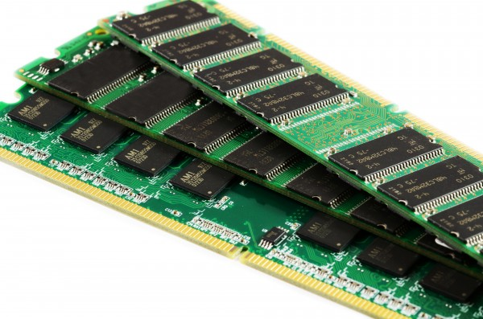
Introduction
Resources are allocated to each program by the operating system.
RAM (physical main memory) is a resource that is used by programs as working space.
Modern computer operating systems are multi-tasking.
RAM

Slide 4
Class Activity 1 (5 mins)
Answer the following questions and share your answers with the class.
Q1: Why is RAM needed?
Q2: What is the implication of multi-tasking, in terms of RAM usage?

Slide 5
Memory Management Functions
Memory management functions include:
Allocating portions of main memory to various programs at their request, and freeing them for reuse when no longer needed
Keeping track of the status of each location of main memory
Protecting the memory that has been allocated to a program from unauthorized access by other programs

Slide 6
Main Memory Map
Operating system and user programs are loaded into RAM
Example:
Note: The numbers indicate memory addresses. “0x” means hexadecimal format.
0x0000
User Programs
(e.g. winword.exe,
powerpnt.exe, msn.exe)
0x8000
Operating System
(Kernel + system data + shared program codes + some reserved areas)
0xFFFF

Slide 7
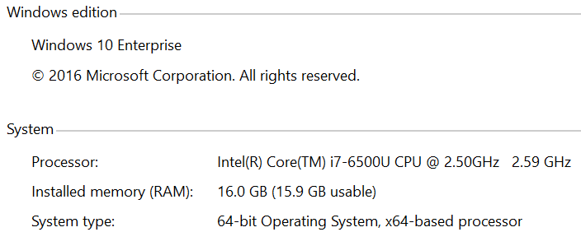
Main Memory
Kernel is the part of OS that is always in RAM as long as the computer is switched on
More than one user program (or application) can be loaded into the User Programs area at the same time
A typical computer system’s information is shown below:
15.9 GB of RAM (usable memory) out of 16.0 GB (installed memory) is assigned as the User Programs area
remaining 0.1 GB is reserved for the hardware

Slide 8
Memory Addresses and Contents
Memory Address:
Memory space is divided into many locations
A binary number is given to a memory location by which it can be referenced (memory location address)
By referencing the address of a location, the content of a memory location can be accessed
The number of bits for the address depends on the address bus width e.g. in slide 6, a 16-bit address (4 hex digits)
Memory Content:
An 8-bit binary (1 byte) number that could be either a part of an instruction or a part of data

Slide 9
Memory Addresses and Contents
0x0000
0xA8
Memory addresses
0x0001
0x2E
Memory contents
0x0002
0x5F
0x0003
0x03

Slide 10
Physical Memory Addresses
Physical memory addresses are the addresses assigned to physical main memory (RAM).
Physical addresses start from 0 to some maximum number determined by the amount of RAM installed in the computer
0x0000
0xA8
Memory addresses
0x0001
0x2E
0x0002
0x5F
0x0003
0x03
:
:
0x88AF

Slide 11
Class Activity 2 (5 mins)
Answer the following question and share your answer with the class.
If the amount of RAM installed in a tiny computer is 256 bytes, state the range of its physical address space in hexadecimal number format.
If the amount of RAM installed in a tiny computer is 65,536 bytes, state the range of its physical address space in hexadecimal number format.

Slide 12
Logical Memory Addresses
CPU assumes each program uses a contiguous memory with addresses starting from 0 to some maximum number
E.g. a program size of 16 bytes, addresses from 0x0 to 0xF
These addresses used (or referenced) by a CPU are logical addresses

Slide 13
Class Activity 3 (5 mins)
Answer the following question and share your answer with the class.
Explain the difference between logical and physical addresses.

Slide 14
Virtual Memory
Due to multi-tasking, multiple programs have to be loaded into physical memory (RAM)
Some programs e.g. OS kernel, have to be in RAM all the time
The total memory size required by the OS and all the programs with their data may exceed the physical memory size (installed RAM)
There is a limit to the maximum amount of RAM that can be installed in a computer system
There is also cost involved in increasing the amount of installed RAM

Slide 15
Virtual Memory – cont.
When the total memory size required by the OS and all the programs has exceeded the physical memory size, OS uses Virtual Memory technique to compensate.
This technique makes use of available space on a disk to temporarily store the programs
When physical memory runs low, OS moves inactive data from physical memory to the temporary space on disk
OS swaps data from disk back to physical memory when required
This technique gives the illusion that the system has much more physical memory than it really does

Slide 16
Demand Paging
Demand Paging is one of the virtual memory allocation schemes
Physical memory (physical address space) is divided into fixed and equal-sized blocks called frames.
Processes and their data are also divided into fixed and equal-size blocks called pages.
Frame size = page size; 4096 bytes (4KB) is a typical size.
Page numbers and frame numbers both start from 0
Pages that are being referenced by the CPU are to be loaded into frames
Note: In demand paging, it is possible that some pages are not referenced (demanded) during a particular run of a process. Such pages will not be loaded into RAM at all during that run of the process.

Slide 17
Demand Paging – cont.
If there are no more free frames in physical memory, one or more of the pages in physical memory will be placed in a special file in a disk .
In Windows OS, the file is named pagefile.sys and is found in the root directory of a disk partition (volume).
In Linux and Unix systems a disk partition is used instead and is called the swap space or swap partition.
The page that is paged out to the disk is selected based on some replacement algorithm such as Least Recently Used policy.
If the pages in the disk are required by the CPU again, they will be swapped with some other pages in physical memory.

Slide 18
Demand Paging (Graphically)
Logical Address Space of Process A
(divided into pages)
Physical Address Space
(divided into frames)
Part of Process A
Part of Process A
Note: 2 pages of Process A are in physical memory frames; the remaining pages are in disk.
Disk
Slide 18
Slide 18

Slide 19
Demand Paging (Graphically)
Logical Address Space of Process B
(divided into pages)
Logical Address Space of Process A
(divided into pages)
Physical Address Space
(divided into frames)
Part of Process B
Part of Process A
Part of Process B
Part of Process A
Disk
Slide 19
Slide 19

Slide 20
Page Fault
Page fault is said to occur when a page required by the CPU is not found in physical memory.
When a page fault occurs, the OS will swap in the required page from the page file in the disk.

Slide 21
Page Table
A page table is a data structure that is used by the OS to keep track of which page is in which frame in RAM and, which pages are in the page file in the disk.
There is a page table maintained for each process.

Slide 22
Simple Example of a Page Table
Page Number | Valid / Invalid Control Bit | Frame Number
3 | 0 | 1991
2 | 1 | 2010
1 | 1 | 2009
0 | 0 | 1000
The page table for a process (say A) is shown above.
For ease of illustration, decimal numbers ( instead of binary) are used in this example.
The Valid/Invalid bit indicates whether the page is in RAM:
0 = invalid => Page is not in RAM; it is in the page file in the disk
1 = valid => Page is in RAM and it is loaded into the indicated frame

Slide 23
Simple Example of a Page Table – cont.
Page Number | Valid / Invalid Control Bit | Frame Number
3 | 0 | 1991
2 | 1 | 2010
1 | 1 | 2009
0 | 0 | 1000
So, Page 1 and Page 2 of process A are currently found in Frame 2009 and Frame 2010 respectively of the RAM
Whereas Page 0 and Page 3 are in the page file in the disk, not in RAM.

Slide 24
Simple Example of a Page Table – cont.
Note:
There are other control bits besides the Valid/Invalid bit.
There is a “dirty” bit which indicates whether the content of the page have been modified so that the OS knows whether to write back the page into disk.
There are also some security bits to indicate the security level for the page (e.g. can be shared with other processes or not)

Slide 25
Class Activity 4 (15 mins)
Instruction:
Use a piece of A4 size paper to work out the following. Paste your answer in Teams channel.
Question:
The maximum logical (virtual) address space of 32-bit Windows applications is usually limited to 4 GB (2³² bytes). The default page size is 4 KB (2¹² bytes).
(i) Calculate the maximum number of pages for such an application. (You may leave your answer in whatever format you like.)
(ii) What is the maximum number of page table entries for such a process?
(iii) If the installed amount of physical memory (RAM) in a computer is 1GB, calculate the maximum number of frames that can be obtained with this memory.

Slide 26
Class Activity 4 cont’d
(iv) Will all of the above process be able to be loaded into the RAM? Why?
(v) Describe what is usually done in operating systems to solve the problem of required virtual memory is usually more than installed RAM.

Slide 27
Virtual Memory in Windows 10
If the computer lacks RAM needed to run a program, Windows uses Virtual Memory to compensate
Virtual Memory combines the RAM with temporary space (paging file) on disk
When RAM runs low, data (pages) is/are moved to the paging file to free up RAM so that the computer can complete its work

Slide 28
Class Activity 5 (Resource Monitor – Resmon)
Instruction:
Do this activity in Week 5
Download the activity from Mel

Slide 29
Page Fault and Thrashing
If a page is not found in RAM and currently in the paging file on disk, a page fault occurs.
The page has to be swapped from disk to RAM which slows down the program execution as disk is slower than RAM.
If the computer spends most of the time moving pages between disk and RAM due to page faults, the performance of the computer is reduced (known as thrashing).
Thrashing is detected by monitoring page fault frequency.

Slide 30
Preventing Low Memory Problems
When your computer does not have enough memory for all the actions it is trying to perform, Windows and your programs can stop working.
To help prevent information loss, Windows will notify you when your computer is low on memory.
You can also learn to recognize the signs of low memory and take steps to prevent the problem.

Slide 31
Signs of Low Memory
Signs of low memory include
poor performance,
low memory or out of memory notifications, and
display problems.
For example, if you try to open a menu in a program when your computer is low on memory, the program might respond slowly or appear to stop responding.
If the menu appears, it might not respond when you try to click an item or it might not display all items.
If you click a menu item, the menu might also disappear and leave a blank area on the screen instead of displaying the contents of the document or file in which you're working.

Slide 32
How to prevent low memory problems?
Increase the paging file size
Install more RAM
Determine if a program overuses memory and close it
Note: Closing unused programs or running fewer programs at a time can help but may not be practical.
Notes:
Windows automatically attempts to increase the paging file size the first time your computer becomes low on memory, but you can also manually increase it up to a maximum size that is determined by the amount of RAM installed. Although increasing the paging file size can help prevent low memory problems, it can also make your programs run more slowly. Because your computer reads information from RAM much faster than from a hard disk (where the paging file is), making too much virtual memory available to programs will slow them down.
If you see signs of low memory or if Windows warns you about a low memory problem, check the information that came with your computer or contact the computer manufacturer to determine which type of RAM is compatible with your computer, and then install more RAM. To install RAM, check the information provided by the manufacturer.
If the computer becomes low on memory whenever you run certain programs, one or more of those programs might have a memory leak. To stop a memory leak, you need to close the program. To repair a memory leak, you need to check for updates for the program or contact the publisher of the software

Slide 33
How to prevent low memory problems?
The more RAM your computer has, the faster your programs will generally run.
If a lack of memory is slowing your computer, you might be tempted to increase virtual memory to compensate.
However, your computer can read data from RAM much more quickly than from a disk, so adding RAM is a better solution.

Slide 34
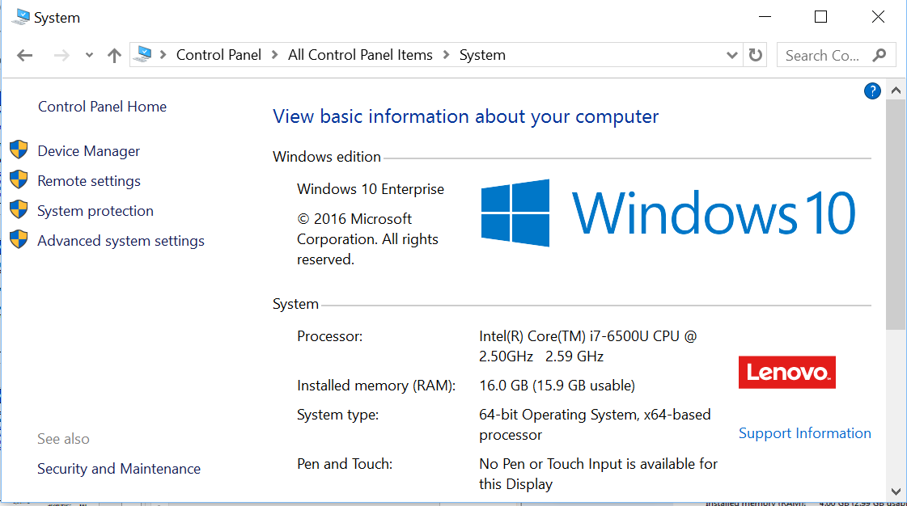
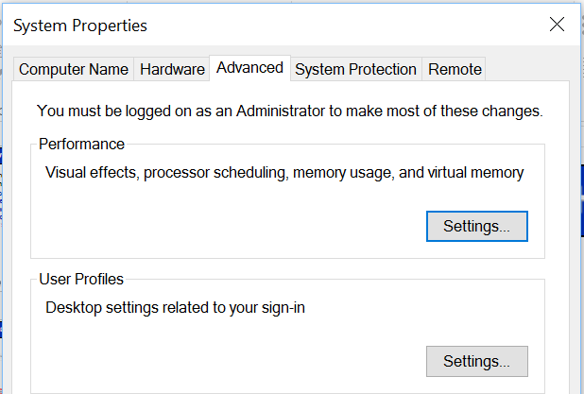
How to change VM size?

Slide 35
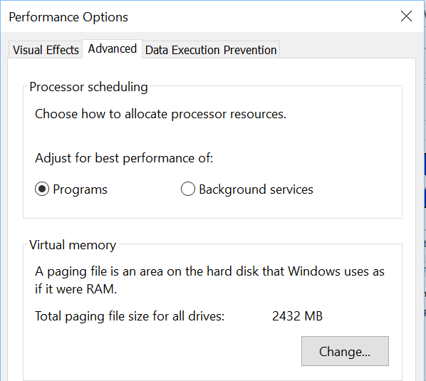
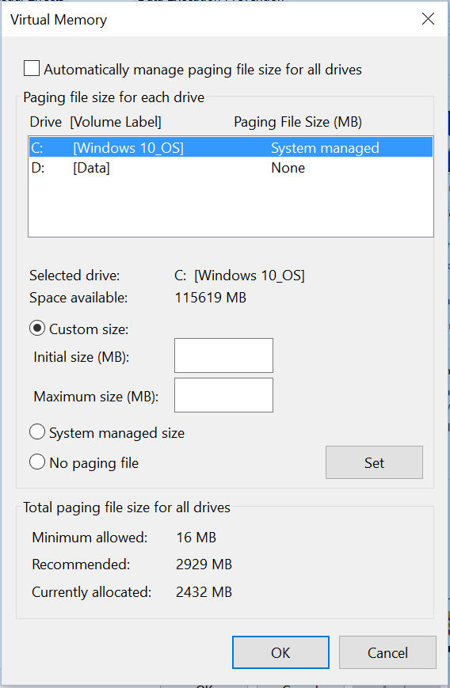
How to change VM size?
Click Custom size, type a new size in megabytes in the Initial size (MB) or Maximum size (MB) box, click Set, and then click OK

Slide 36
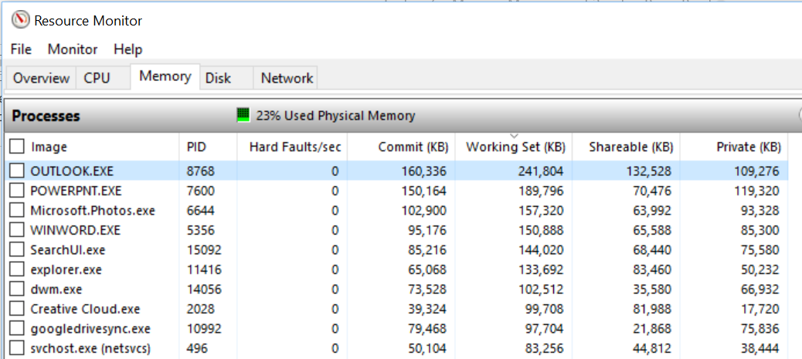
Determine if a program overuses memory
Start Resource Monitor, click on the Memory tab.
To sort programs by memory usage, click Working Set (KB)

Slide 37
Summary
RAM (physical main memory) is a resource that is used by programs as working space.
The total memory size required by the OS and all the programs with their data may exceed the physical memory size (installed RAM).
When the total memory size required by the OS and all the programs exceed the physical memory, OS uses Virtual Memory technique to compensate.
Demand Paging is one of the virtual memory allocation schemes.

Slide 38
Summary
Page fault occurs when a page required by the CPU is not found in physical memory.
There are several ways to prevent low memory problem.

